Slide 1

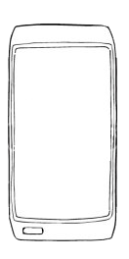



+
Client: Kidz Toyz
Project Title: Kidz Toyz Mobile Integrated App
Product Name: ToyBox
Lead Designer: Alex Mackenzie
Synopsis: Kidz Toyz seeks a product that will:
Enhance the in-store experience (increase purchases per user utilizing this product)
Drive brand loyalty (awareness and perception)
Proposal: Create a mobile App that becomes an integral part of the buyers shopping habits for toys. Introducing “The Toy Box,” a revolutionary way of buying toys, this mobile application will have features that will closely resemble a social media “toy box.”

Slide 2


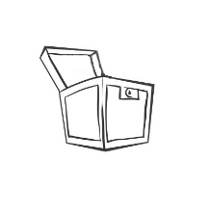
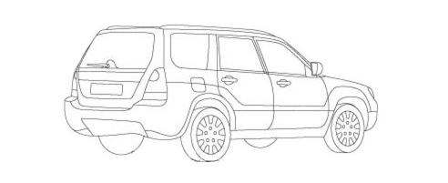

The ToyBox
The App will identify a user within 1000 feet (customizable) of its physical store (GPS) and send a notification to visit Kidz Toyz.
Upon entering the store, the App will send out a notification greeting, ping social media, and ping the store managers too (identify and greet VIP customers via business rules).
Welcome back Alex ! Kidz Toyz
20 % Off
Your Next In-store Purchase
CLICK FOR DIRECTIONS
Click for Today’s Special
Your account has been updated
AlexanderCoxMackenzie.com

Slide 3
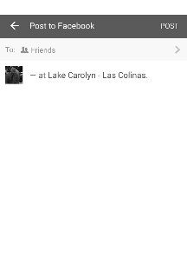

The ToyBox
Upon entering the store, shoppers can “check-in” and earn reward points (brand loyalty).
Each FB, Tweet, Instagram, or other social media entries utilizing #KidzToyz will also earn them reward points (posted via the App / building brand perception).
#KidzToyz for 1000 pts
AlexanderCoxMackenzie.com

Slide 4

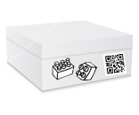

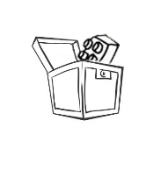
The ToyBox
While in-store, the App will act as their virtual shopping cart with a simple point and click scan-reader (may allow high dollar items to remain out of reach as shoppers scan from a display).
Once an item is added to the virtual cart, the App will provide add-on notices like “This item requires 2 AA batteries, would you like to add that to your cart?”
Lego Adventure successfully added to your ToyBox
+1 item
AlexanderCoxMackenzie.com

Slide 5
The ToyBox
At check out, the shopper can select delivery or store-pick up. Either way, the payment can be made via the App and the patron’s smart device (in-store purchases that drop ship save on replenishment and inventory control costs / perhaps in-store drop ships earn bonuses).
Shipping can be made to other addresses, with gift-wrap options too.
AlexanderCoxMackenzie.com

Slide 6
The ToyBox
The experience becomes paperless allowing for “green” promotions (improving brand perception).
Tie receipts to a shoppers profile making “returns” easier on the shopper while providing data for the company to analyze (cost analysis, demographics, etc.).
The last minute shopper, “Uncle Alex,” who always forgets his niece’s birthday could quickly browse, find, select, and ship whether instore or on the go with the ToyBox.
The App will also help with calling nearest store, proving store hours, directions, wish list, and even comparison-shopping if desired.
AlexanderCoxMackenzie.com

Slide 7
The ToyBox
Let the in-store shoppers become your connection to greater brand awareness and perception. This App is the hybrid shopping experience and bridge between in-store and online experiences maximizing the profitability of both while providing the customer with choice and convenience.
AlexanderCoxMackenzie.com

Slide 8
The Thought Process
When approaching a design, I consider several factors:
Time until project completion
Resources available during time frame
Level of quality required
Although every project deserves ample time and resources, sometimes you just have to work with what you got.
Before I begin, I divide the tasks into phases with phase one being a restatement and sometimes a sketch iteration to confirm a full understanding of the project.
Phase 2 usually involves a detailed walk through of interaction and ideation, while keeping an eye on scope to prevent scope creep.
Phase 3 is a low fidelity walk though seeking approval of the interactions, content, flow, and monitoring client interest.
During each individual phase, depending on time and resources, daily standups and critiques are done to gather peer input. This is what I call “iron sharpening iron,” because it involves some heat and friction as designers haggle over thoughts, techniques, execution, and sometimes taste and preference. Few companies allow for this luxury.
Ultimately, I align my design process with that of the client and company. It works best to have a well-oiled machine rather than be that lone part that irritates the engine.
AlexanderCoxMackenzie.com

